Slide 1
Hill Cipher
Present by Group 6

Slide 2
Hill Cipher and How It works
Hill Cipher Encryption Code
Overview
Hill Cipher Decryption Code
Implement Hill Cipher into chatting on LAN

Slide 3
Hill Cipher and How It works
Hill Cipher Encryption Code
Overview
Hill Cipher Decryption Code
Implement Hill Cipher into chatting on LAN

Slide 4
Hill Cipher and How It works
Suppose we have a message “ACT” with a given key size is 3x3 as below
6
24
1
A
0
13
16
10
C
2
20
17
15
T
19
m = 3

Slide 5
Hill Cipher and How It works
Suppose we have a message “ACT” with a given key size is 3x3 as below
6
24
1
0
67
15
13
16
10
2
222
14
( mod 26 )
20
17
15
19
319
7
ENCRYPTED:
POH

Slide 6
Hill Cipher and How It works
Suppose we have a message “ACT” with a given key size is 3x3 as below
ENCRYPTED:
POH
-1
6
24
1
8
5
10
13
16
10
( mod 26 )
21
8
21
20
17
15
21
12
18

Slide 7
Hill Cipher and How It works
Suppose we have a message “ACT” with a given key size is 3x3 as below
ENCRYPTED:
POH
8
5
10
15
P
260
0
21
8
21
14
O
574
2
( mod 26 )
21
12
18
7
H
539
19
DECRYPTED:
ACT

Slide 8
Hill Cipher and How It works
Hill Cipher Encryption Code
Overview
Hill Cipher Decryption Code
Implement Hill Cipher into chatting on LAN
Message is checked to ensure that its length is a multiple of the size of the key matrix. If not, the string is appended with an 'X' to ensure that the length of the string is a multiple of the size of the key matrix.

Slide 9
Hill Cipher Encryption Code
MESSAGE:
AC
ACT
KEY:
Message is checked to ensure that its length is a multiple of the size of the key matrix. If not, the string is appended with an 'X' to ensure that the length of the string is a multiple of the size of the key matrix.
6
24
1
13
16
10
20
17
15
m = 3
MESSAGE:
ACX
ACT

Slide 10
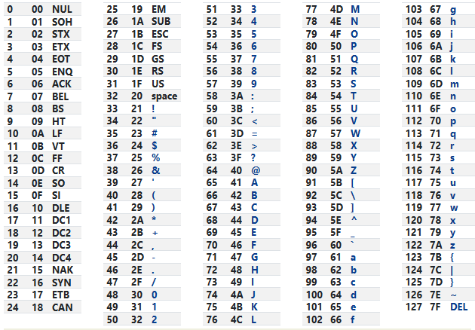
Hill Cipher Encryption Code
Plaintext
[lengthOfKey, messageLength / lengthOfKey]
MESSAGE string is converted to a matrix of alphanumeric values. Each character in the string is converted to a numeric value that corresponds to the space between the character and the distance in the ASCII encoding. These numeric values are stored in a plaintext matrix.
MESSAGE:
ACT
33
35
52
MESSAGE:
ACTTCA
33
52
35
35
52
33

Slide 11
Hill Cipher Encryption Code
Plaintext
[lengthOfKey, messageLength / lengthOfKey]
MESSAGE string is converted to a matrix of alphanumeric values. Each character in the string is converted to a numeric value that corresponds to the space between the character and the distance in the ASCII encoding. These numeric values are stored in a plaintext matrix.
MESSAGE:
ACT
33
35
52
MESSAGE:
ACTTCA
33
52
35
35
52
33

Slide 12
Plaintext
[lengthOfKey, messageLength / lengthOfKey]
Hill Cipher Encryption Code
Ciphertext
[lengthOfKey, messageLength / lengthOfKey]
Plaintext
Ciphertext
33
52
35
35
52
33
ciphertext is calculated by multiplying the key matrix by the plaintext matrix
6
24
1
33
52
1090
1185
13
16
10
35
35
1509
1566
20
17
15
52
33
2035
2130

Slide 13
Plaintext
[lengthOfKey, messageLength / lengthOfKey]
Hill Cipher Encryption Code
Ciphertext
[lengthOfKey, messageLength / lengthOfKey]
Plaintext
Ciphertext
33
52
35
35
52
33
Then modulo 94 (cause from |SPACE| 32 to “}” 125: 125 – 32+1 = 94)
1090
1185
56
57
1509
1566
5
( mod 94 )
62
2035
2130
61
62

Slide 14
Plaintext
[lengthOfKey, messageLength / lengthOfKey]
Hill Cipher Encryption Code
Ciphertext
[lengthOfKey, messageLength / lengthOfKey]
Plaintext
Ciphertext
33
52
56
57
35
35
5
62
52
33
61
62
The result is ciphertext matrix

Slide 15
Plaintext
[lengthOfKey, messageLength / lengthOfKey]
Hill Cipher Encryption Code
Ciphertext
[lengthOfKey, messageLength / lengthOfKey]
Finally, the ciphertext matrix is converted back into a sequence of characters based on the alphabet. Each numeric value in the matrix is converted back to the character corresponding to the space between that character and the space character in the ASCII encoding. The end result of the encoding is returned as a string.
Ciphertext
56
5
61
57
62
62
X
%
]
Y
^
^
MESSAGE:
ACTTCA
PLAINTEXT:
ACTTCA
MESSAGE:
ACTT
PLAINTEXT:
ACTTXX

Slide 16
Plaintext
[lengthOfKey, messageLength / lengthOfKey]
Hill Cipher Encryption Code
Ciphertext
[lengthOfKey, messageLength / lengthOfKey]
Finally, the ciphertext matrix is converted back into a sequence of characters based on the alphabet. Each numeric value in the matrix is converted back to the character corresponding to the space between that character and the space character in the ASCII encoding. The end result of the encoding is returned as a string.
56
5
61
57
62
62
Ciphertext
X
%
]
Y
^
^
PLAINTEXT:
ACTTXX
CIPHERTEXT:
******

Slide 17
Plaintext
[lengthOfKey, messageLength / lengthOfKey]
Hill Cipher Encryption Code
Ciphertext
[lengthOfKey, messageLength / lengthOfKey]
Finally, the ciphertext matrix is converted back into a sequence of characters based on the alphabet. Each numeric value in the matrix is converted back to the character corresponding to the space between that character and the space character in the ASCII encoding. The end result of the encoding is returned as a string.
56
5
61
57
62
62
Ciphertext
X
%
]
Y
^
^
CIPHERTEXT:
******
PLAINTEXT:
ACTTXX

Slide 18
Plaintext
[lengthOfKey, messageLength / lengthOfKey]
Hill Cipher Encryption Code
Ciphertext
[lengthOfKey, messageLength / lengthOfKey]
Finally, the ciphertext matrix is converted back into a sequence of characters based on the alphabet. Each numeric value in the matrix is converted back to the character corresponding to the space between that character and the space character in the ASCII encoding. The end result of the encoding is returned as a string.
56
5
61
57
62
62
Ciphertext
X
%
]
Y
^
^
ENCRYPTED:
******~6
CIPHERTEXT:
******
messageLength = 6
PLAINTEXT:
ACTTXX
6
MESSAGE:
ACTT

Slide 19
Ciphertext
[lengthOfKey, messageLength / lengthOfKey]
Hill Cipher Encryption Code
Finally, the ciphertext matrix is converted back into a sequence of characters based on the alphabet. Each numeric value in the matrix is converted back to the character corresponding to the space between that character and the space character in the ASCII encoding. The end result of the encoding is returned as a string.
Ciphertext
X
%
]
Y
^
^
~
6

Slide 20
Hill Cipher and How It works
Hill Cipher Encryption Code
Overview
Hill Cipher Decryption Code
Implement Hill Cipher into chatting on LAN

Slide 21
Hill Cipher Decryption Code
Ciphertext
X
%
]
Y
^
^
~
6

Slide 22
Ciphertext
[lengthOfKey, messageLength / lengthOfKey]
Hill Cipher Encryption Code
messageLength = 6
Ciphertext
X
%
]
Y
^
^
The function starts by splitting the cipherText into two parts: the first part is the encrypted string and the second part is the length of the original message. The function then calculates the length of the cipherMatrix based on the length of the cipherText and the size of the key matrix.
56
5
61
57
62
62

Slide 23
messageLength = 6
Ciphertext
X
%
]
Y
^
^
Hill Cipher Encryption Code
cipherMatrix
56
57
5
62
61
62
Store values in cipherText in terms of a matrix of size [lengthOfKey, cipherTextLength / lengthOfKey]
KEY:
6
24
1
13
16
10
20
17
15

Slide 24
cipherMatrix
56
57
5
62
61
62
Hill Cipher Encryption Code
KEY:
6
24
1
13
16
10
20
17
15
We need to find det(A) to know the inverse of matrix key
Matrix A = (a_{ij})_{nxn}
det(A) = a_{i1}A_{i1} + a_{i2}A_{i2} + … + a_{in}A_{in} (i = 1,2,3,…,n)
A_{ij} = (-1)^{i+j} M_{ij}
6
24
1
13
16
10
20
17
15

Slide 25
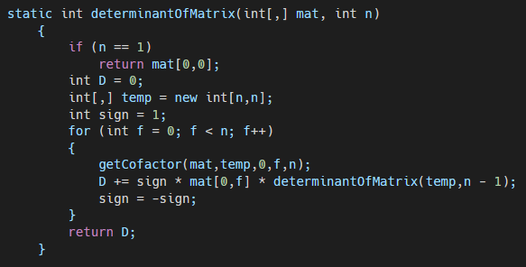
Hill Cipher Encryption Code
KEY:
Matrix A = (a_{ij})_{nxn}
6
24
1
det(A) = a_{i1}A_{i1} + a_{i2}A_{i2} + … + a_{in}A_{in} (i = 1,2,3,…,n)
A_{ij} = (-1)^{i+j} M_{ij}
13
16
10
20
17
15
det(A) = 6A₁₁ + 24A₁₂ + 1A₁₃
Store values in cipherText in terms of a matrix of size [lengthOfKey, cipherTextLength / lengthOfKey]
det(A) = 6(-1)¹⁺¹M₁₁ + 24(-1)¹⁺²M₁₂ + 1(-1)¹⁺³M₁₃
13(-1)¹⁺¹17 + 16(-1)¹⁺²20
13(-1)¹⁺¹15 + 10(-1)¹⁺²20
16(-1)¹⁺¹15 + 10(-1)¹⁺²17

Slide 26
Hill Cipher Encryption Code
KEY:
Matrix A = (a_{ij})_{nxn}
6
24
1
det(A) = a_{i1}A_{i1} + a_{i2}A_{i2} + … + a_{in}A_{in} (i = 1,2,3,…,n)
A_{ij} = (-1)^{i+j} M_{ij}
13
16
10
20
17
15
det(A) = 6A₁₁ + 24A₁₂ + 1A₁₃
det(A) = 6(-1)¹⁺¹M₁₁ + 24(-1)¹⁺²M₁₂ + 1(-1)¹⁺³M₁₃
DET:
441 = 65 (mod 94)

Slide 27
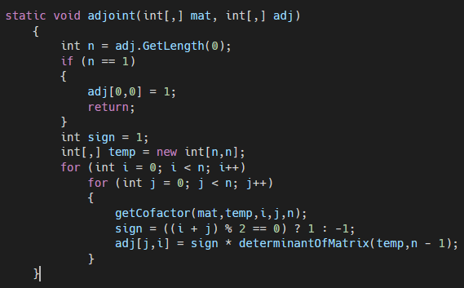
Hill Cipher Encryption Code
KEY:
6
24
1
DET:
65
A⁻¹ = det(A)⁻¹ C^{T}
13
16
10
20
17
15
16
10
13
10
13
16
+
-
+
17
15
20
15
20
17
24
1
6
1
6
24
-
+
-
17
15
20
15
20
17
24
1
6
1
6
24
+
-
+
16
10
13
10
13
16

Slide 28
Hill Cipher Encryption Code
KEY:
6
24
1
DET:
65
A⁻¹ = det(A)⁻¹ C^{T}
13
16
10
20
17
15
16
10
13
10
13
16
+
-
+
17
15
20
15
20
17
24
1
6
1
6
24
-
+
-
17
15
20
15
20
17
24
1
6
1
6
24
+
-
+
16
10
13
10
13
16

Slide 29
Hill Cipher Encryption Code
KEY:
6
24
1
DET:
65
A⁻¹ = det(A)⁻¹ C^{T}
13
16
10
20
17
15
C
70
5
- 99
- 343
70
378
224
- 47
- 216

Slide 30
Hill Cipher Encryption Code
KEY:
6
24
1
DET:
65
A⁻¹ = det(A)⁻¹ C^{T}
13
16
10
20
17
15
C^{T}
70
- 343
224
5
70
- 47
- 99
378
- 216

Slide 31
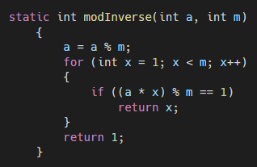
Hill Cipher Encryption Code
KEY:
6
24
1
DET:
65
A⁻¹ = det(A)⁻¹ C^{T}
13
16
10
65
94
20
17
15
C^{T}
70
- 343
224
5
70
- 47
- 99
378
- 216
det(A)⁻¹ = 81

Slide 32
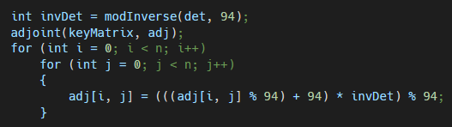
Hill Cipher Encryption Code
KEY:
6
24
1
DET:
65
A⁻¹ = det(A)⁻¹ C^{T}
C^{T}
70
- 343
224
30
41
2
13
16
10
20
17
15
A⁻¹ =
det(A)⁻¹ = 81
5
70
- 47
29
30
47
- 99
378
- 216
65
68
82

Slide 33
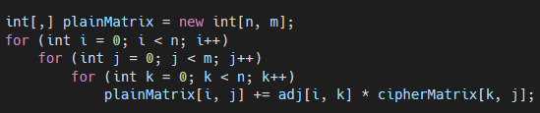
Hill Cipher Encryption Code
adj[]: A⁻¹
cipherMatrix
30
41
2
56
57
33
52
PLAINTEXT:
29
30
47
5
62
35
35
( mod 94 )
65
68
82
61
62
52
33

Slide 34
Hill Cipher Encryption Code
33
52
65
84
A
T
+|SPACE| (32)
35
35
67
67
C
C
52
33
84
65
T
A

Slide 35
Hill Cipher Encryption Code
A
T
Convert to string plaintext
C
C
Plaintext = “ACTTCA”
T
A

Slide 36


Slide 37
Introducing
DHP Lan Chat

Slide 38

DHP Lan Chat

Slide 39

DHP Lan Chat

Slide 40
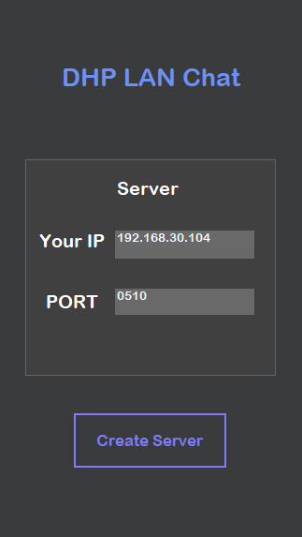
DHP Lan Chat
Auto detect your LAN IP
Enter random port

Slide 41
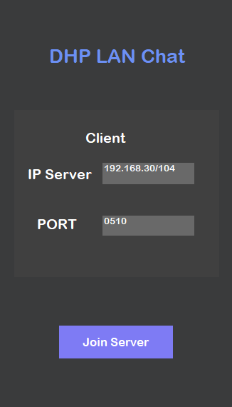
DHP Lan Chat
Enter the IP server you want to join
Server port

Slide 42
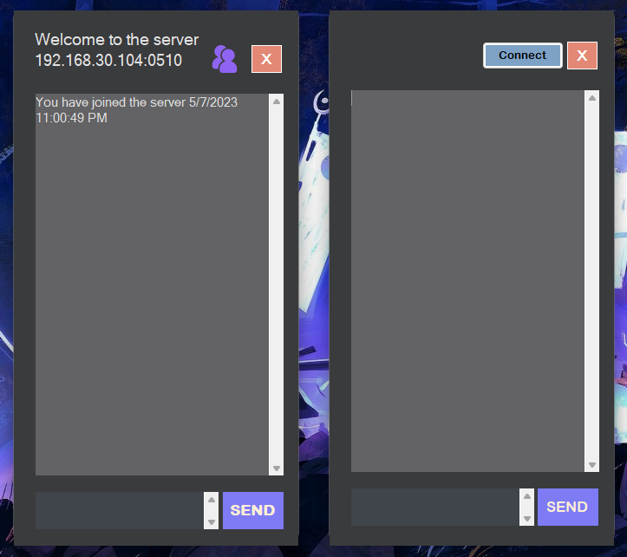
DHP Lan Chat
Click to connect to server

Slide 43
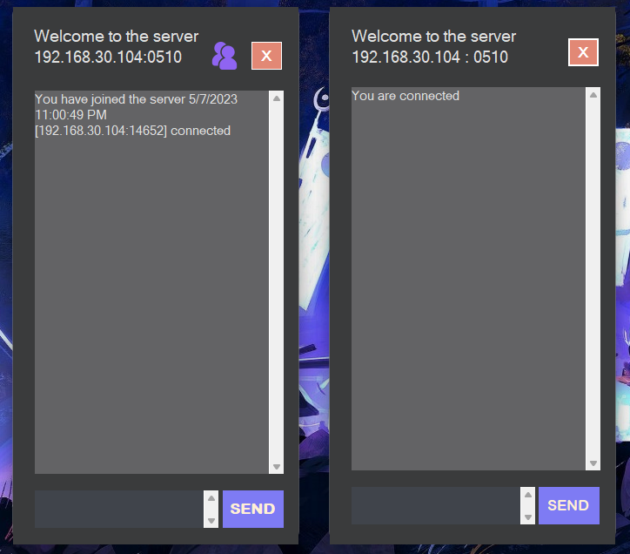
DHP Lan Chat

Slide 44
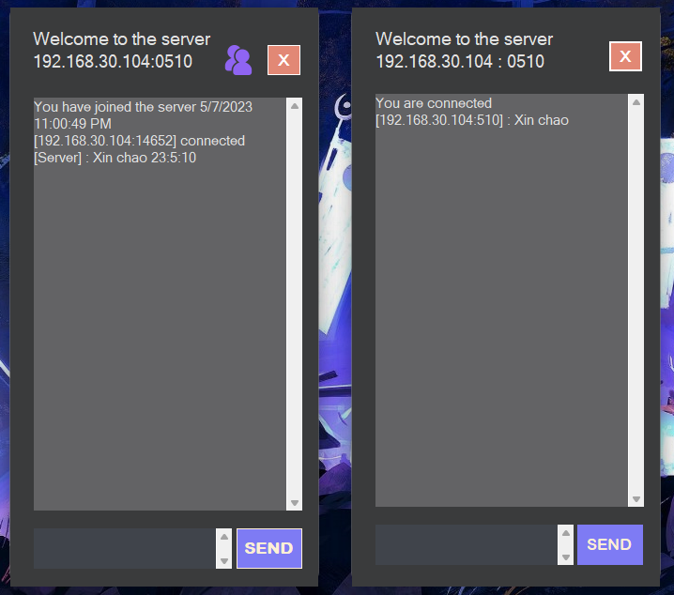
DHP Lan Chat

Slide 45
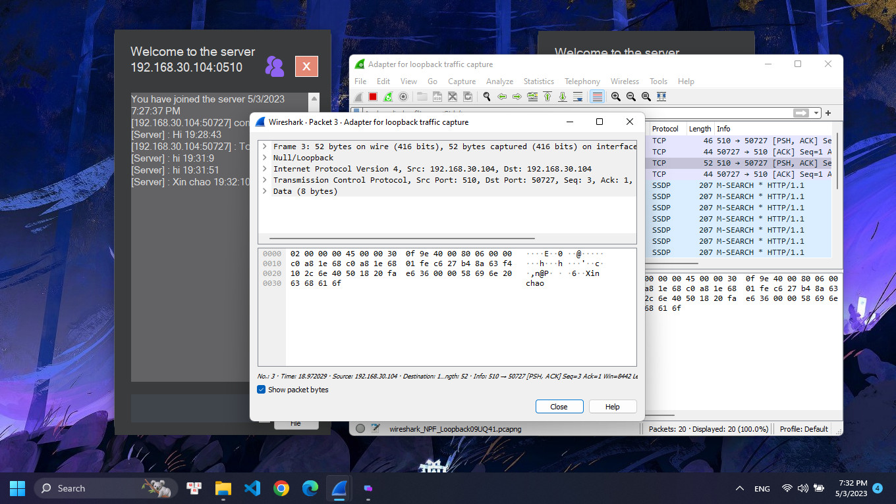
DHP Lan Chat
Without Hill Cipher

Slide 46
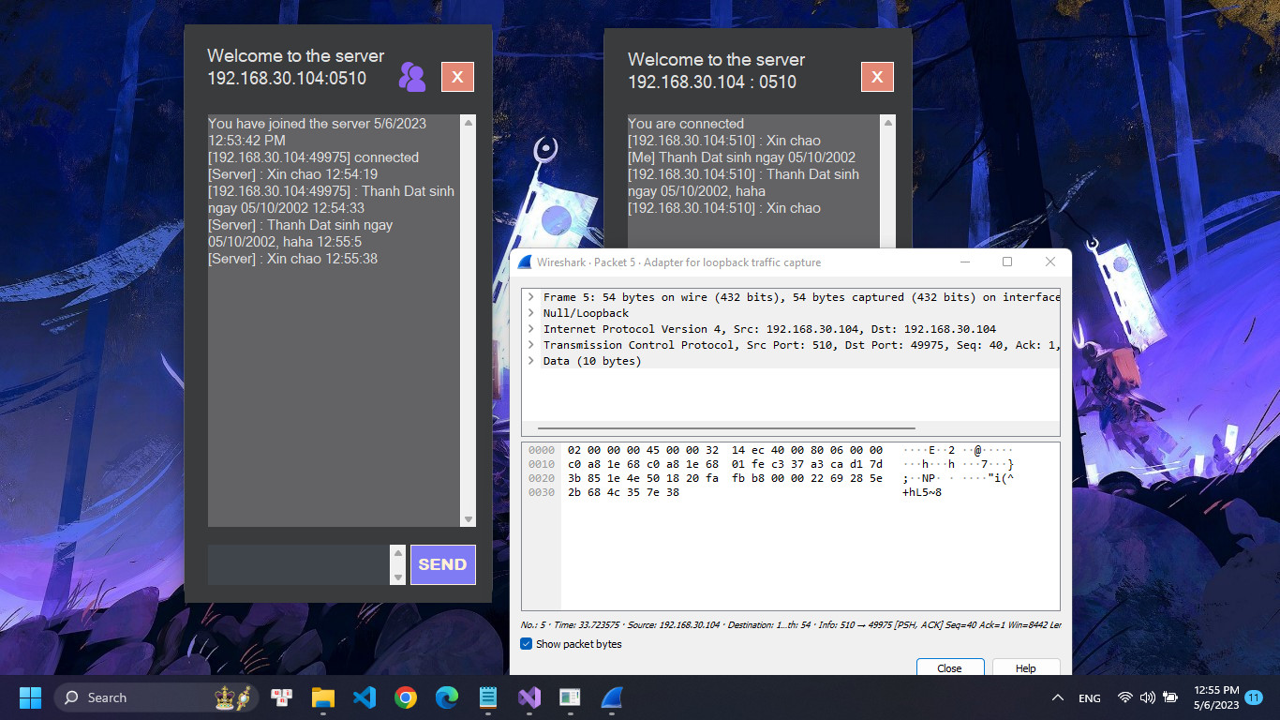
DHP Lan Chat
With Hill Cipher

Slide 47

Thank you for watching
You can scan this QR code to download the app
Source code available on github: joi-lightyears (Thanh Dat) (github.com)

